Slide 1
AIRFRAME PROGRESS REPORT
WEEK 6
15/06/2023

Slide 2
THIS WEEK’S OBJECTIVES
To complete the rolling the aluminum sheets
Rocket Bend Test
Proceed with the parachute test

Slide 3
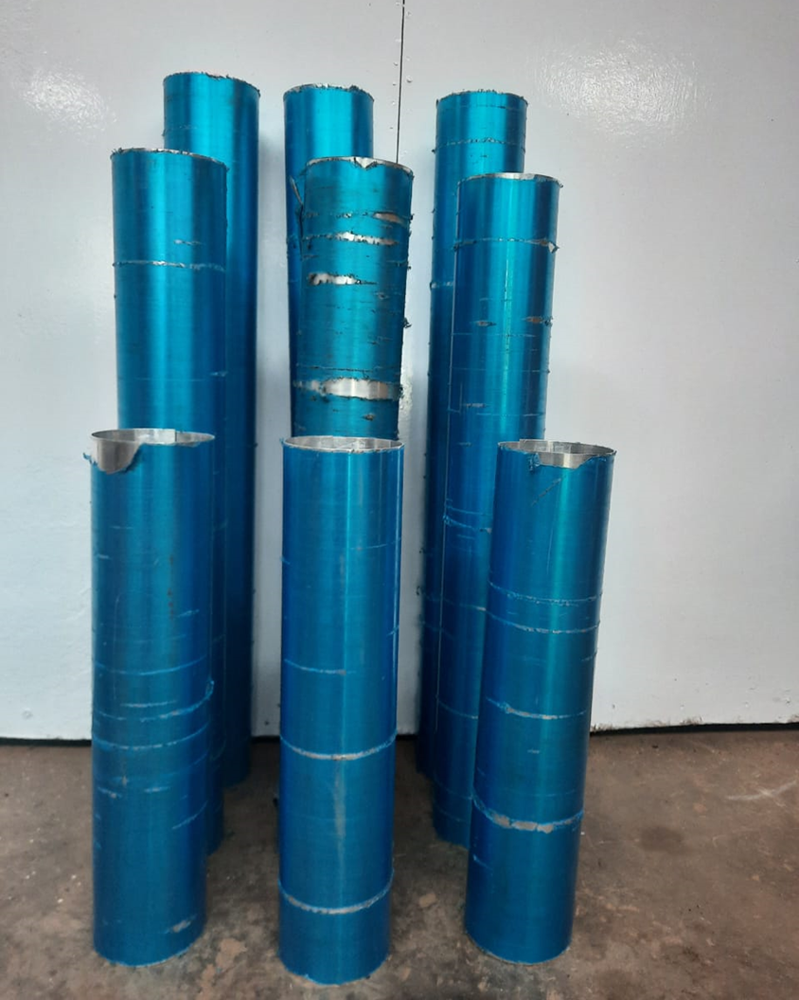
Aluminium rolling
L=720 mm
L=620 mm
400 mm
3 airframe tubes

Slide 4
Structural Testing
Fin loading
Rocket bending Test

Slide 5
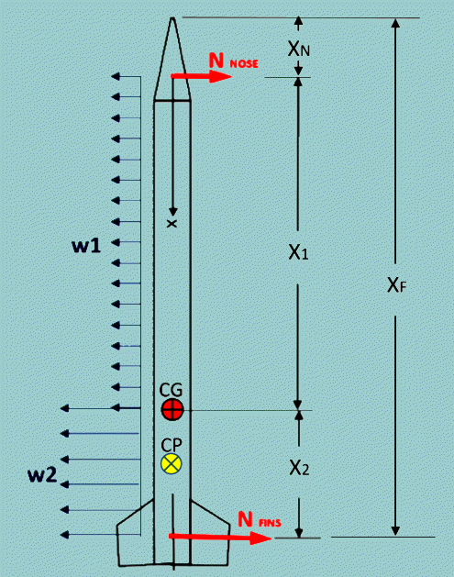
Fin Loading
Fins generate lift and this lift puts a bending load on the fin mounting (where it is attached to the body tube).
Test weight: Needs to be 2x the expected maximum aerodynamic bending load
Illustration of inertial and aero forces acting on a rocket body in-flight

Slide 6
The lift coefficient (CL) depends on the angle of attack (angle with the airflow). For a reasonably stable rocket an angle of attack of 2 deg. can be assumed
Lift = ½ x Air Density x Velocity2 x CL x Fin Area
Air Density = 1.225 kg/m³
Velocity = Maximum velocity of the rocket (m/s)
CL = Lift coefficient of the fin design (unitless)
Fin Area = Plan form area of a single fin (m²)
𝑁_{𝐹𝐼𝑛𝑠} = 1⁄2∗ 𝜌*𝑣*𝐴*𝐶_{𝐹} = 0.5 × 1.225 × (230*2) × 12 ×0.01
= 3,888.15 𝑁
𝑁_{𝐹𝐼𝑛𝑠} ≅ 3,888.15 N i.e 396.35 kgs

Slide 7
Nose Lift:
Nose lift is calculated in a similar manner as the fins. The only difference is the “area” that is used. The area is the cross-sectional area of the nose cone when viewed from the aft end
𝑁𝑁𝑜𝑠𝑒 = 1⁄2∗ 𝜌*𝑣*𝐴*𝐶_{n}
= 1 2 × 1.225 × 2302 × 0.006 × 2
= 388.815 𝑁
𝑁𝑜𝑠𝑒 ≅ 390 𝑁
But 1 kg=9.81 N, therefore…
N_{𝑁𝑜𝑠𝑒} ≅ 39.7689 Kg

Slide 8
Safety factor of 1.5 is selected.
Test Load =39.7689 Kg * 1.5 = 59.65335 Kg
Bending Test Procedure
Hang the weights on the body tube at the base of the nose cone and right in front of the fins.
These are not the exact positions of the lifting loads, but our safety factor (x1.5) allows us to get away with the approximation

Slide 9
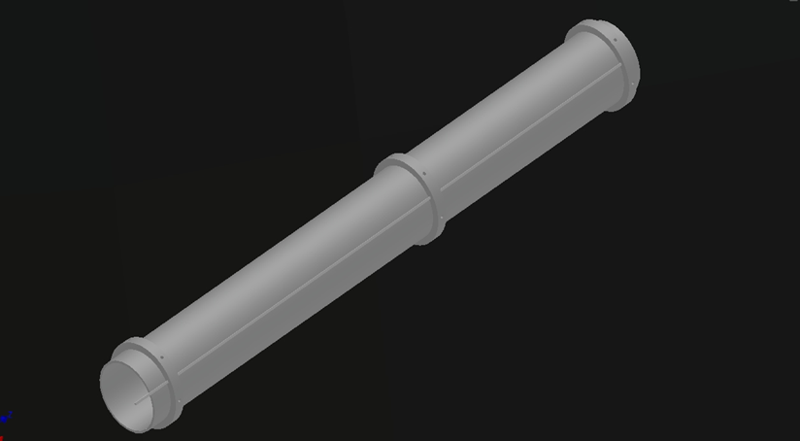
MOTOR MOUNT DESIGN

Slide 10
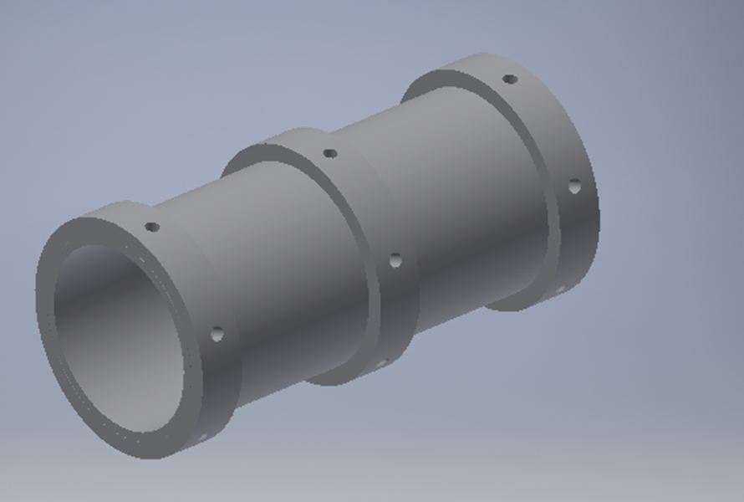
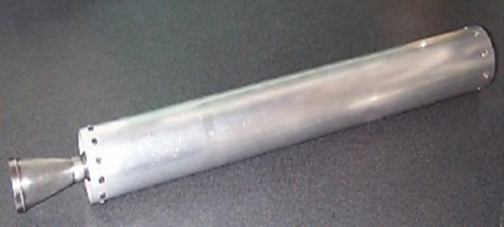
A mount is required to secure the motor in place during flight.
Requirements for the motor mount are:
- It should locate the motor within the skin tube of the airframe.
- It should handle the forces due to the thrust produced by the motor
Motor Mount design
Motor with casing

Slide 11
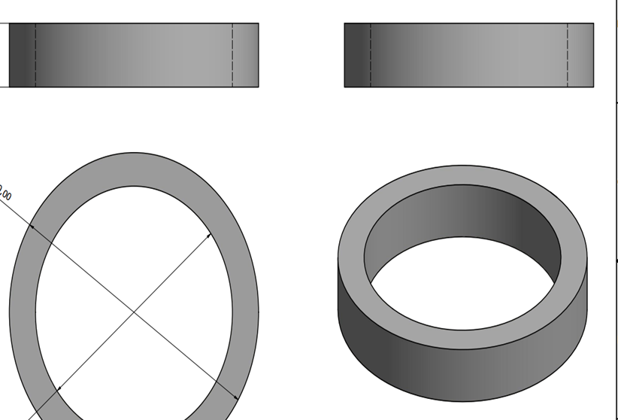
Inner Dia
Outer Dia
To be attached to the inner Dia. of the airframe
The ring designs.

Slide 12
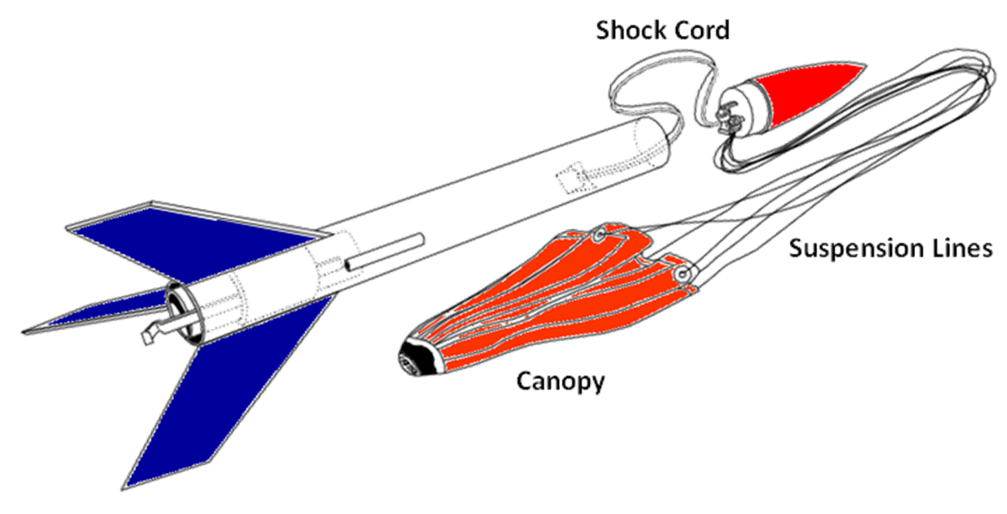
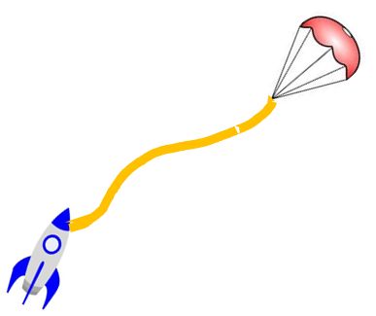
PARACHUTE FOLDING (Videos have been uploaded to google photos)
Timing is important for a smooth recovery.
Ideally is to have it open fast, it inflates quickly to slow down the rocket as fast as possible.
But heavy rocket, this means more stress on the parachute lines.
Model rocket with parachute

Slide 13

Use a little baby powder on the outside and inside and shake it around a little. It always will fully open with no sticking
talcum powder

Slide 14
NEXT WEEK’S OBJECTIVES
RIVETING
ASSEMBLE AND PAINTING OF SECOND FIBREGLASS TUBES
3-D PRINTING OF NOSE CONES
PRESENT CFD ANALYSIS RESULTS

